Slide 1

ELM
Tech Talk by CJ Meeks

Slide 2

Background
Designed by Evan Czaplicki in 2012 as his senior thesis at Harvard
Elm aims to provide a more pleasant experience developing the frontend of web apps

Slide 3
What is Elm?
Elm is a functional language for creating web applications
Uses a functional reactive programming style
Compiles to Javascript
Since it is a pure functional language it can create a graphical layout without any destructive updates

Slide 4
Features
Write HTML and CSS directly in elm file
Syntax is compact
No runtime errors
Elm-reactor - browser based compiler
Pure functions
Immutability

Slide 5
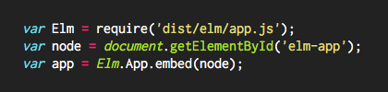
JavaScript Interop
Very easy to try out elm since it compiles to javascript

Slide 6
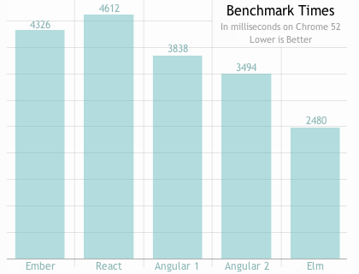
Great Performance

Slide 7
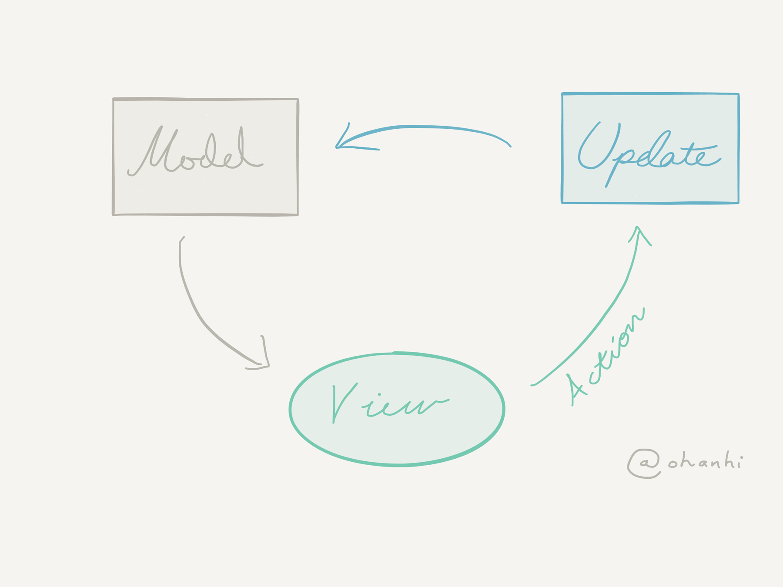
Architecture
Model-The State of your application
Update-A way to update your state
View-A way to view your state as HTML

Slide 8
Pros
It’s not JS(subjective)
The compiler stops you from screwing things up
It’s fast
The framework is built into the language
Hard to write horrible code(elm-format)
Easy to learn
Has its own package manager
Good documentation, not great for beginners

Slide 9
Cons
It’s not mainstream
Community is very small(Less tutorials and help)
High learning curve because of a different syntax
May have to make your own libraries as the language is only 4 years old
Still in Beta

Slide 10
Sources
https://avatars0.githubusercontent.com/u/4359353?v=3&s=280
http://elm-lang.org/assets/home/embed.png
http://elm-lang.org/
https://guide.elm-lang.org/architecture/
http://www.gizra.com/content/thinking-choosing-elm/
http://futurice.com/blog/elm-in-the-real-world

